Slide 1

VIDEO GAMES
Radu Dorian Stamatoiu
Aprilie 2018
Notes:
The purpose of my presentation is to make people aware that video games are the best and most valuable form of entertainment.

Slide 2

Why?
Because the gaming industry has grown into a over $100 billion giant that dwarfs films, books, music and TV.
Notes:
Why? Because the gaming industry has grown a lot in the last years, turning into an industry worth over $100 billion giants, that dwarfs films, books, music and TV.

Slide 3
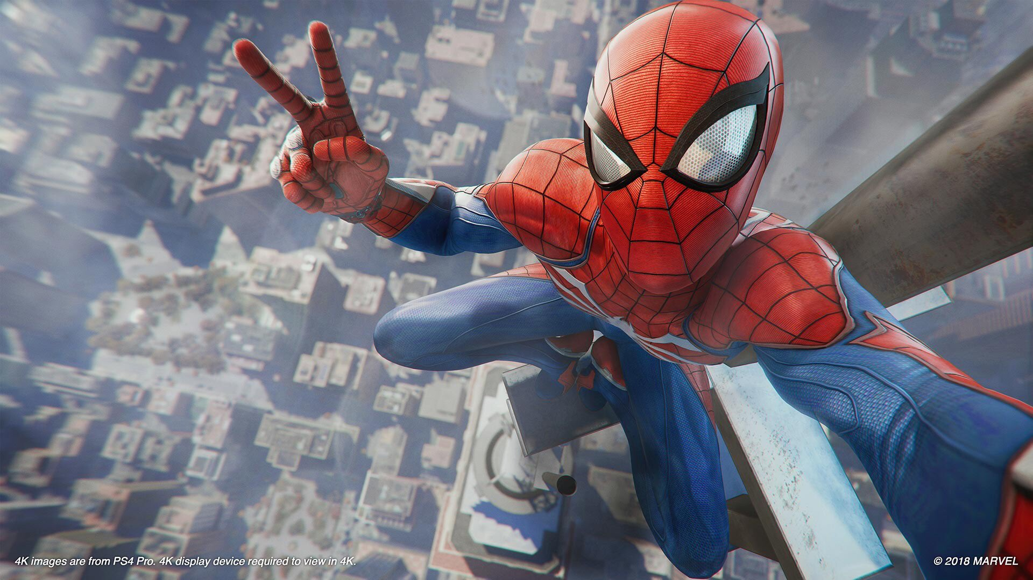




Movies
Games
Revenue
$40B
Costs
$378M
Revenue
$108B
Costs
$265M
Interactivity
None
Interactivity
Total
Notes:
Let’s check a small comparison between movies and video games when it comes to revenue.

Slide 4
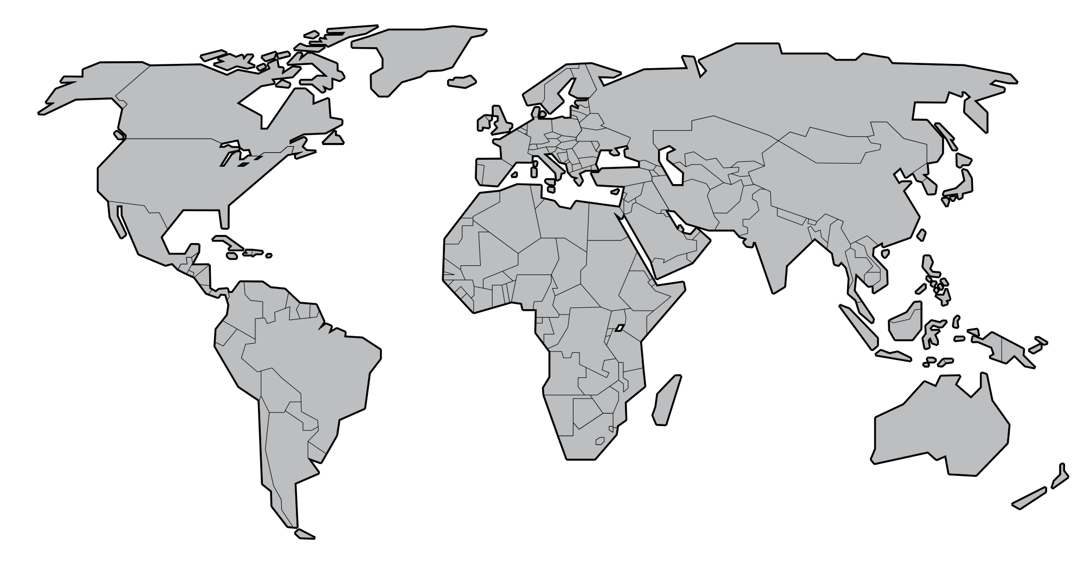




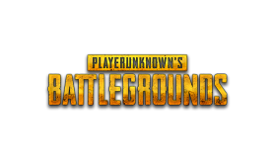


Revenue by country
Just the first three countries make up for more than half of the total global revenue if the industry.
China
1
$32.5B
USA
2
$25.5B
Japan
3
$14B
Romania
47
$163M
Notes:
Okay, gaming is worth more than $100 billion, but which countries contribute the most to this revenue?

Slide 5




Best selling video games
16.3
14.5
9.7
7.3
The revenue, in billions of dollars, of some of the most iconic video games ever made, so far.
Notes:
Obviously, some of the most selling video games are the ones that are very popular.

Slide 6


Okay, but who plays?
When it comes to gender, the gaming population is almost even.
52%
48%
35
Average age
Notes:
1.2 billion people that play games, out of which 700 millions play online. ~5 hours per week.

Slide 7





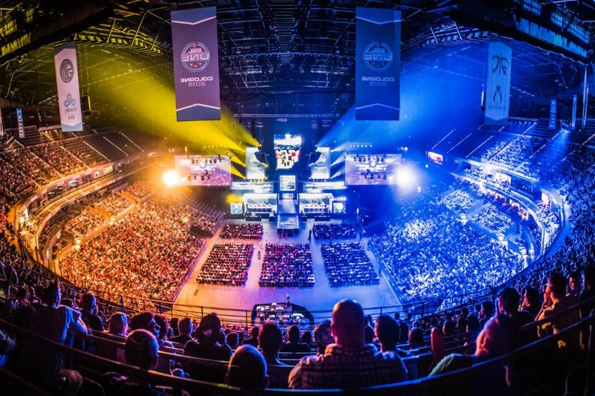


Interactivity unreachable by movies. Immersive, can offer escapism, control over worlds and require more responsiveness.
The gaming industry keeps going strong and each day there are new reasons for why people should really pay more attention to it.
Reasons
What exactly helped gaming grow so big in less than a generation?
Technology advanced and somehow became more accessible, letting more and more people to come in contact with games.
Esports and streaming got very popular. Bigger than real sports events, with huge prizes in almost all competitions.
Notes:
Technology.
Technology evolved and more and more people have access to high end computers and different devices that can provide entertainment in the form of video games. Nowdays, one out of three people own a smartphone.
Interactivity demand.
Video games offer interactivity unreachable by movies. They can also offer escapism, they offer control over whole worlds, they are immersive experiences and require more responsiveness. Movies are like a one-way street, whereas games are interactive, players can control entire worlds. Games evolved and are now way more complex, rather than remaining a linear software with a beginning and an end.
Esports.
A business estimated to reach $1b. As a comparison, at Wimbledon, there's a prize around 3m, and at The International Dota 2 championhp the prize pool was of $25m, the winners taking almost 11m!
The future.
The industry of video games keeps evolving. There's a lot of new technology which helps with this, like VR, AR, MR and so on.

Slide 8
IF
THE GAME
IS NOT
FUN,
WHY BOTHER?
Notes:
But the most important reason I think, it’s because video games are fun. Reggie Fils-Aimé’s quote, which was dedicated to game developers, but can easily be applied to gamers as well. If you don’t like a game, why bother with it? There are thousands other video games out there waiting for you.

Slide 9
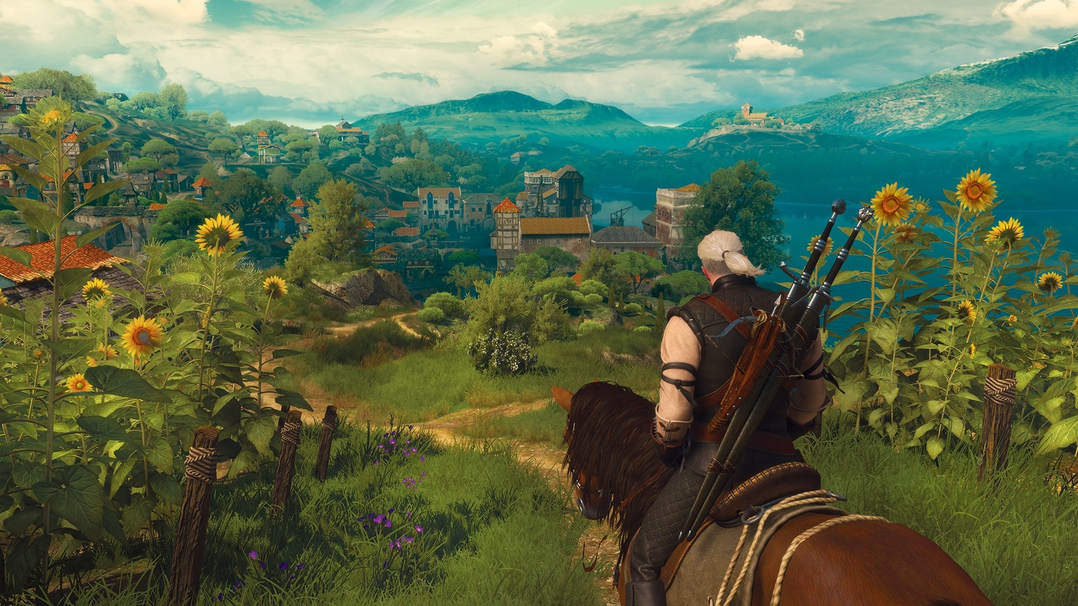
The Witcher 3
Notes:
The Witcher 3 puts you in the skin of a witcher, a mutant, which goes on an epic adventure against The Wild Hunt, set in a fantasy eastern Europe.

Slide 10
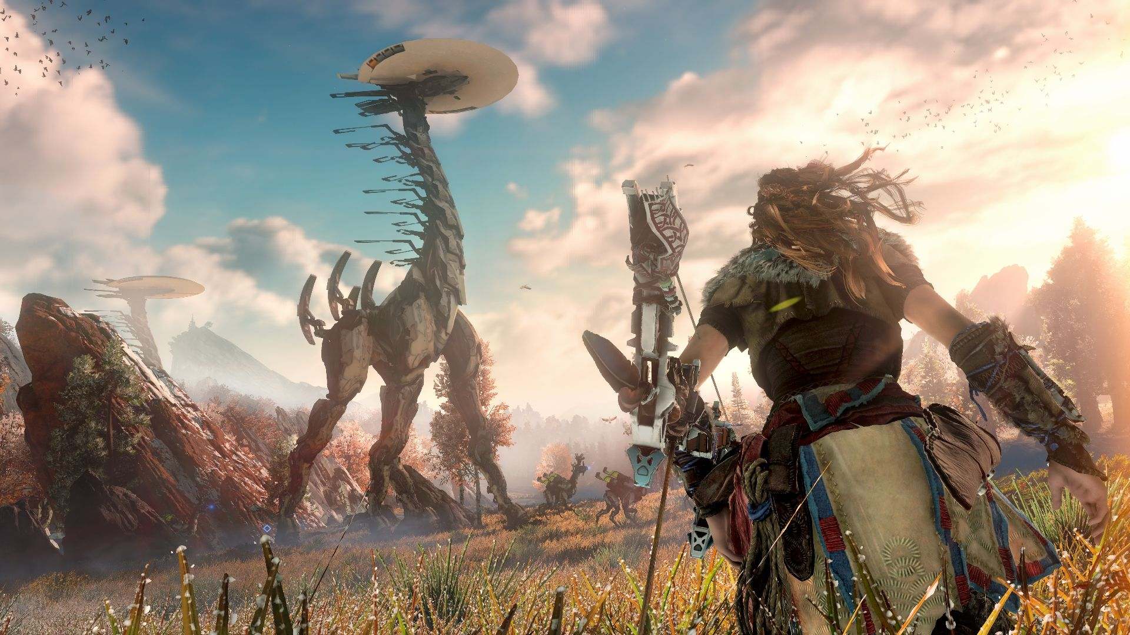
Horizon Zero Dawn
Notes:
Horizon Zero Dawn it’s a sci-fi video game, set in a post-apocalyptic future, where the female protagonist has to go through different adventures through a world filled with giant robotic dinosaurs.

Slide 11
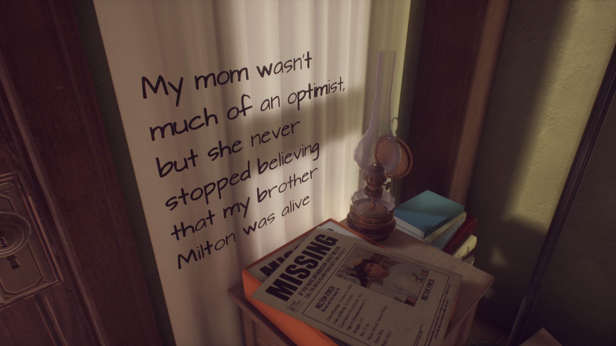
What Remains of Edith Finch
Notes:
What Remains of Edith Finch is a pure example of how narrative experiences can be experienced and interacted with in a video game. I won’t spoil too much, but it’s a story based video game which just won the Bafta prize for the best game of 2017.

Slide 12

Super Mario Odyssey
Notes:
Maybe you want to go back to the roots, and the newest entry in the Super Mario series lets you do just that. With a fully redesigned world and game mechanics, Super Mario Odyssey is one of the best games that came out last year.

Slide 13

Surgeon Simulator
Notes:
Surgeon Simulator let you experience being a not-so-handy surgeon by assigning you buttons to control each finger of the hand. It may sound stupid but… It is. And that’s why it is a funny game. After all… Every good idea borders on the stupid. —Michel Gondry (Eternal Sunshine of the Spotless Mind, The Science of Sleep)

Slide 14
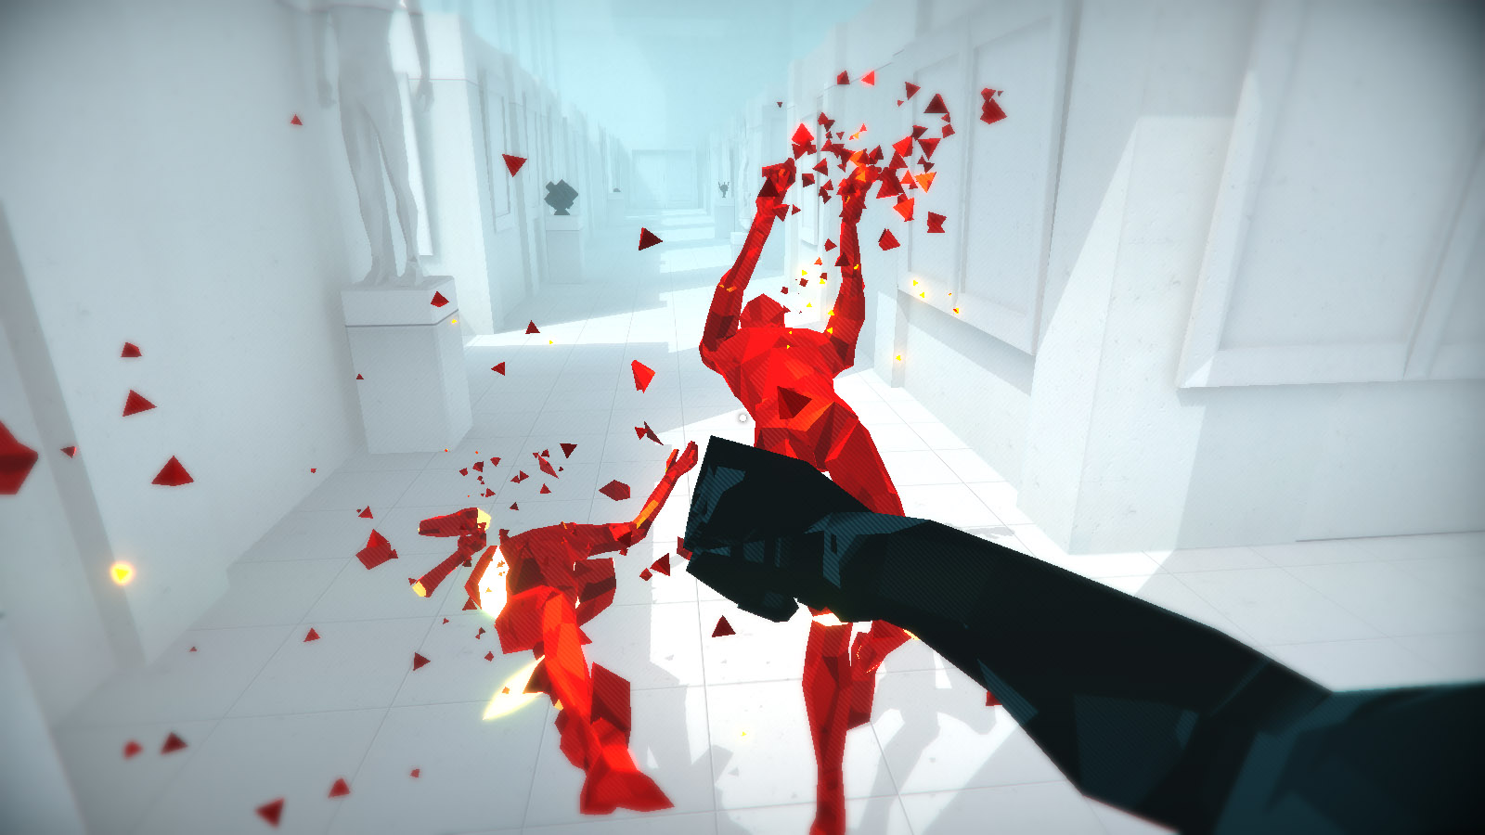
Superhot
Notes:
Superhot is one of the most successful indie games and has one of the best catch-phrase possible. The game is based around the idea that ‘time moves only when you do’. And although it may sound weird, but once you start playing you’ll have a blast.

Slide 15
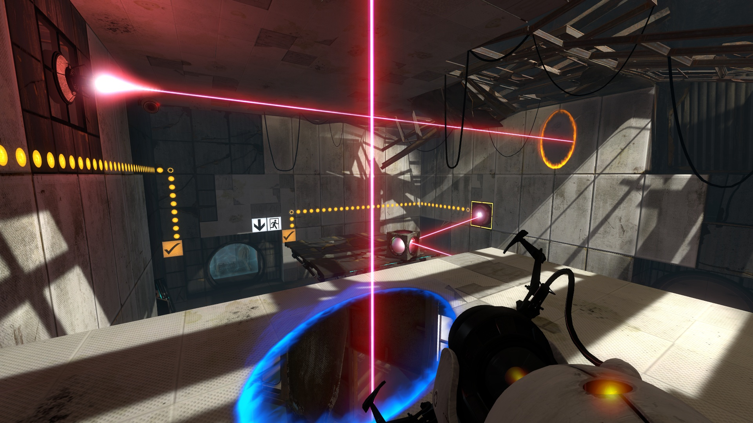
Portal 2
Notes:
Portal 1 and 2 are one of the best puzzle games ever made. They make use of ‘portals’ in order for players to navigate around the levels and resolve different, mind-boggling puzzles. They also have an amazing story and the second one can be played in coop with another friend.

Slide 16
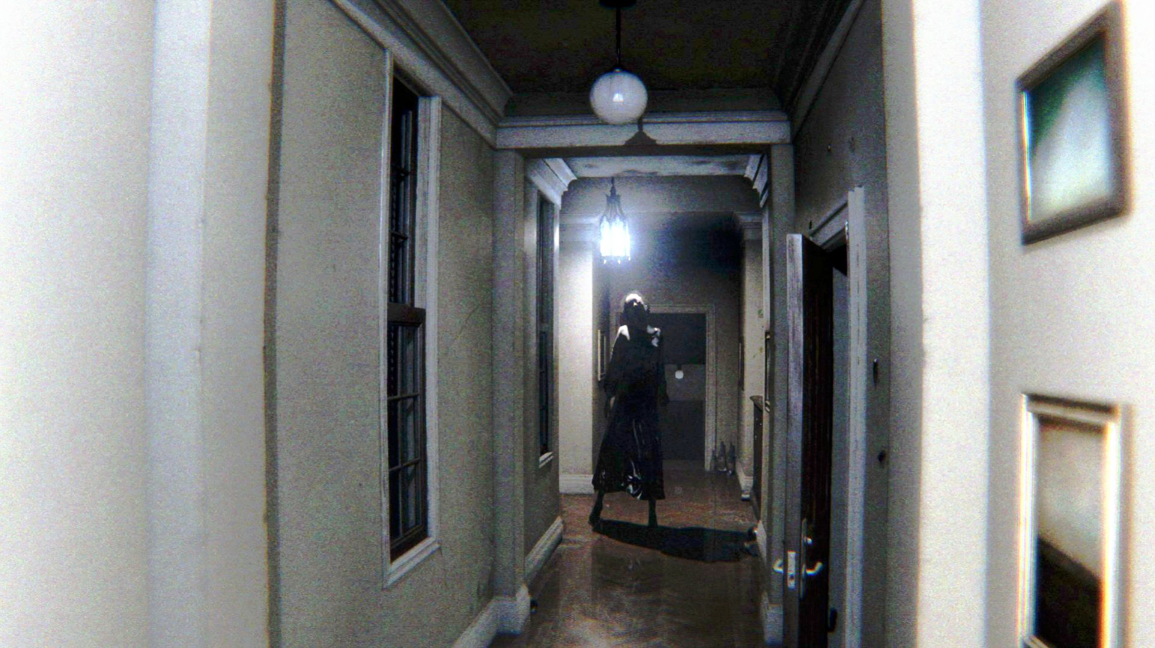
Silent Hill
Notes:
Or if you’re into spooky stuff, the canceled Silent Hill could have been your way to go, because it was creepy, scary and the graphics were incredible.

Slide 17


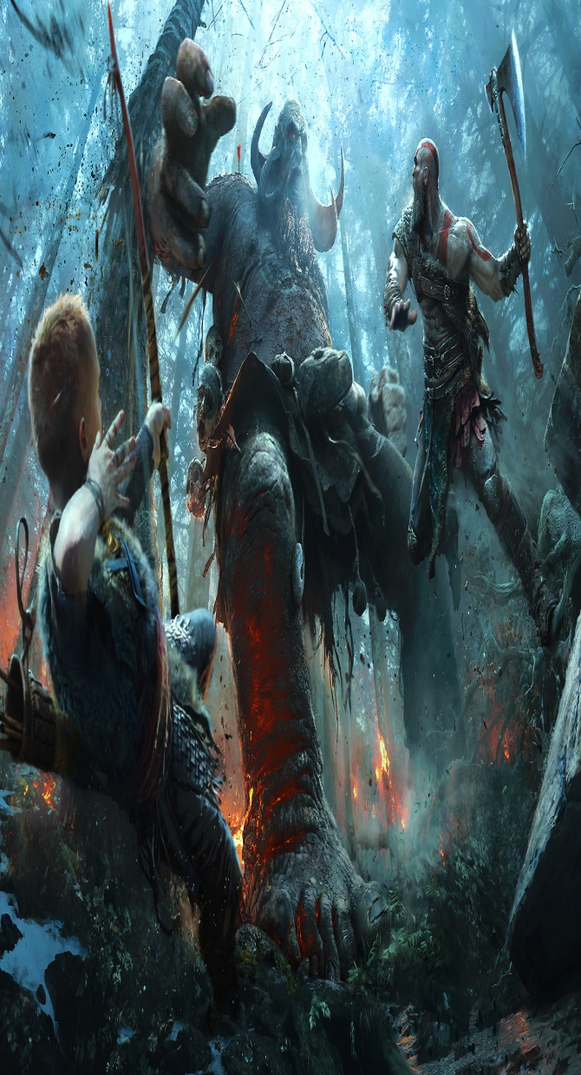

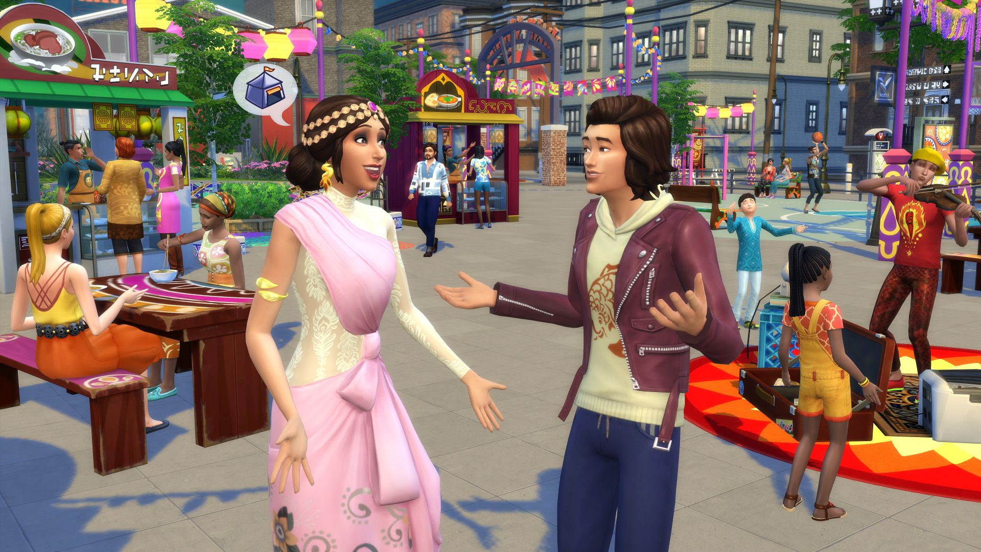
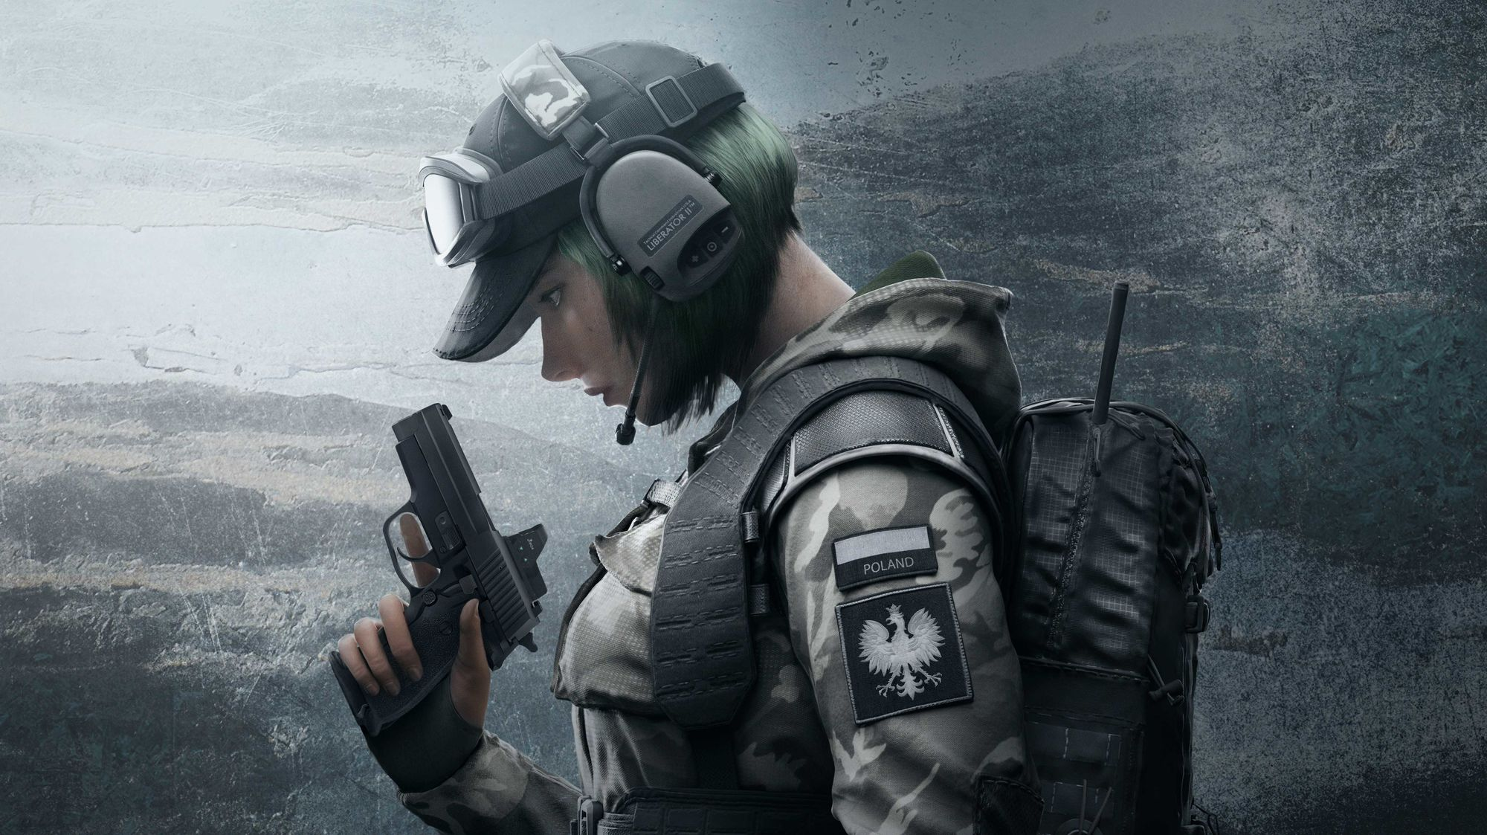

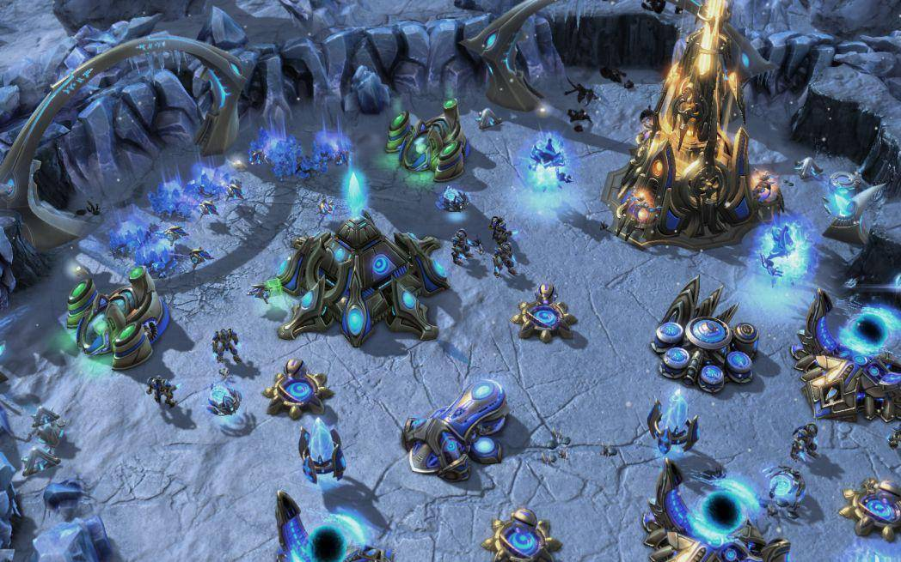

Notes:
No matter what genre of video games are you into, there must be one that will fit you. Which will let you be whoever you want, even if you want to be a hero, a villain, a member of the special forces or even… A bread. Video games create memories and they can be…

Slide 18

THRILLING
Notes:
Nothing compares to sailing around with your friends with your ship full of treasure, when all of a sudden kraken appears out of nowhere to sink your galleon.

Slide 19
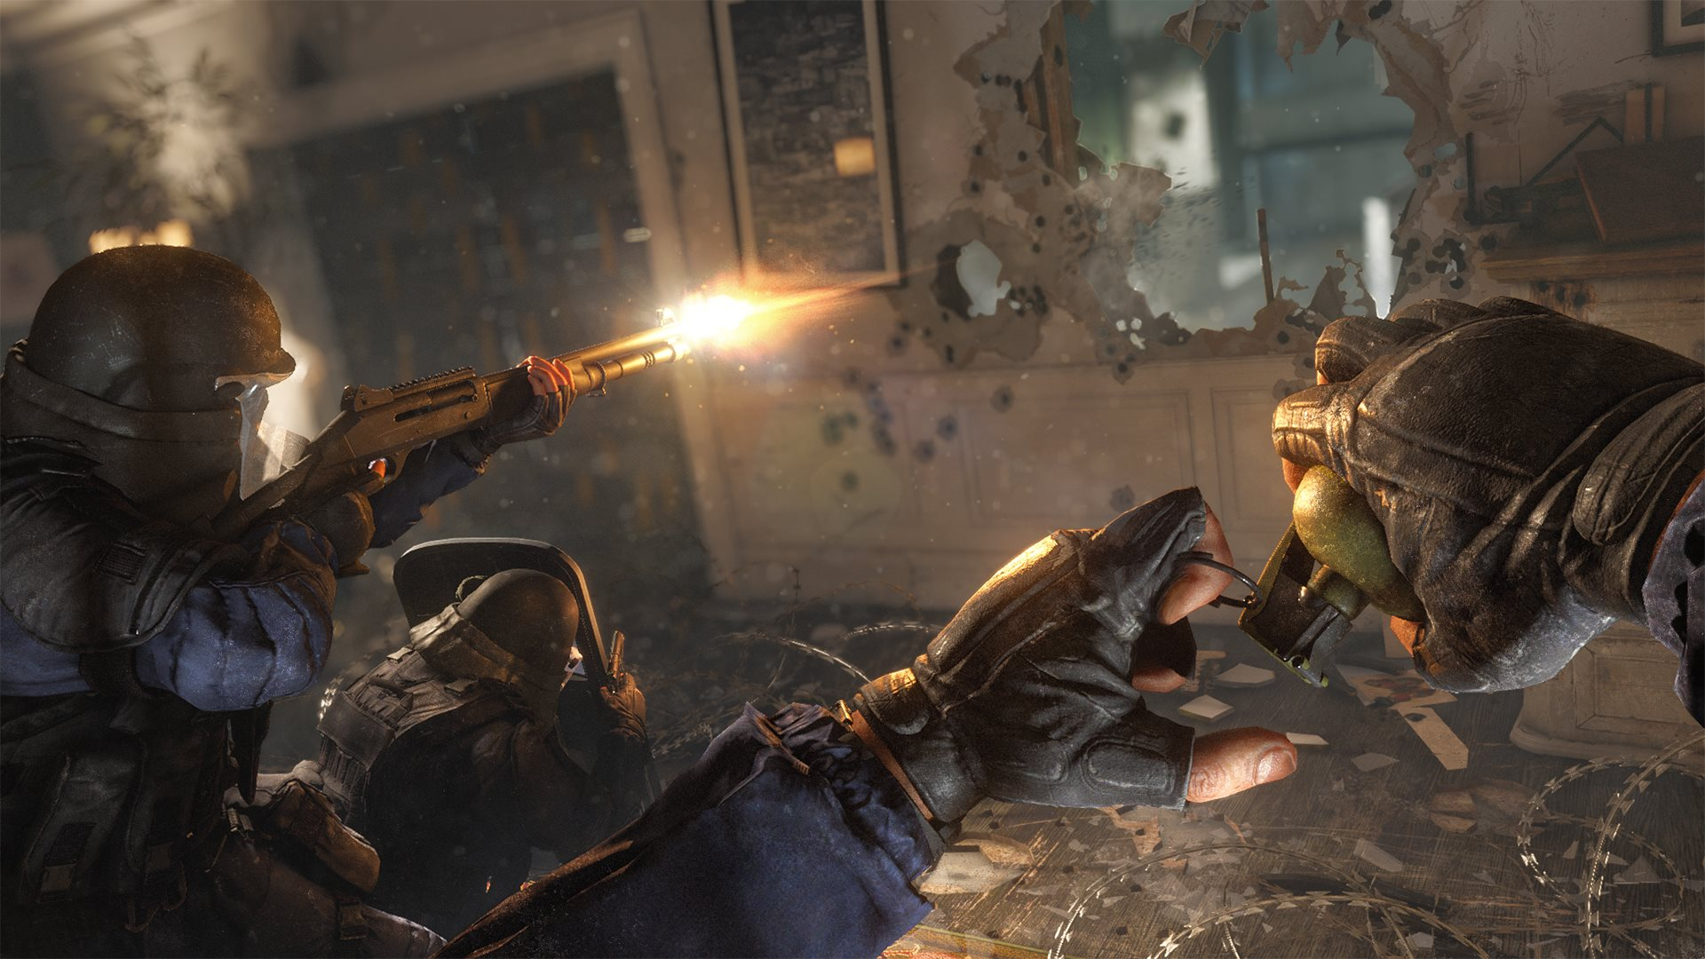
THRILLING
EXCITING
Notes:
As you’re the last member alive of your time and you have a clutch moment, trying to win the match while all your teammates are spectating you and holding their breath as well.

Slide 20
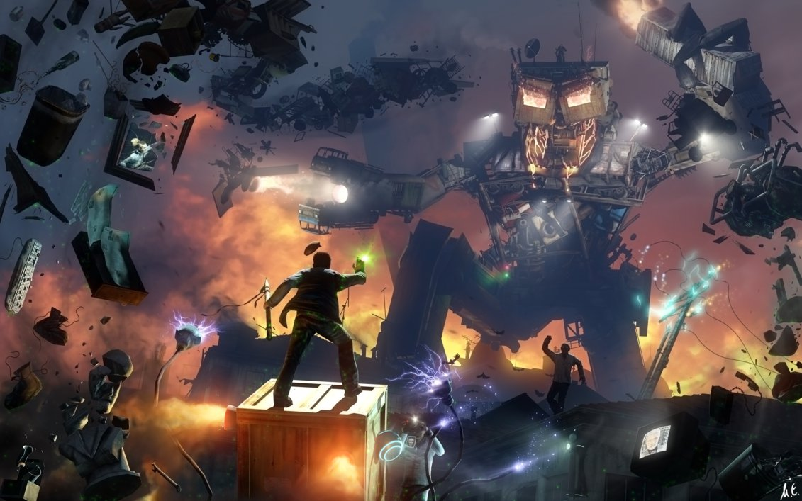
FUNNY
EXCITING
Notes:
They can be funny, because there are a lot of comical moments and a good example would be Garry’s Mod, a sandbox game in which you can create, build and share inventions with all your friends, or play the premade gamemodes like Trouble in Terrorist Town, which is a more advanced, video game verion of the classic Mafia game.

Slide 21
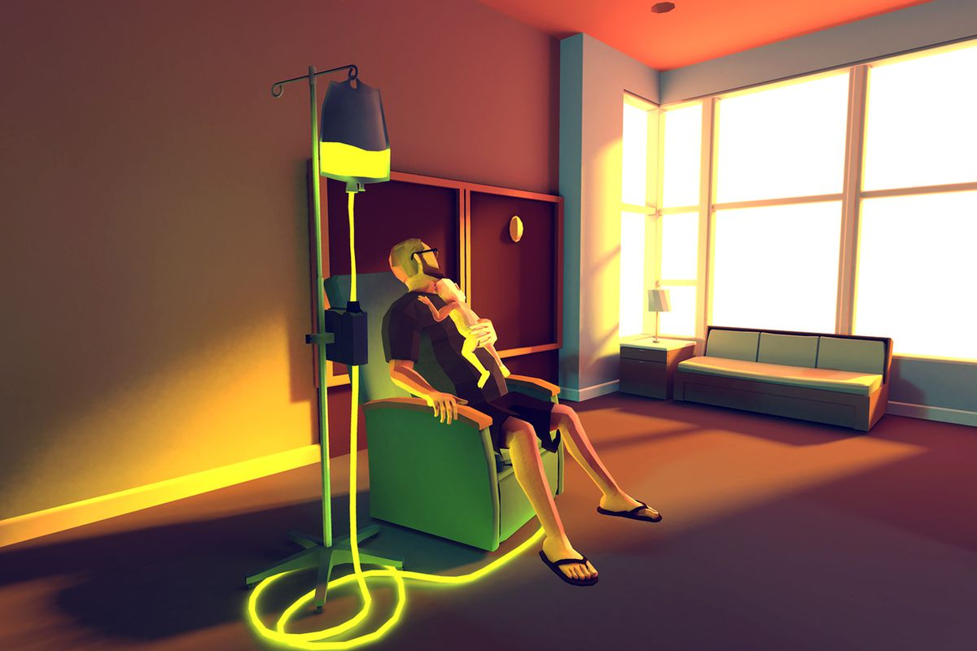
FUNNY
EMOTIONAL
Notes:
And by emotional, I mean sad, like That Dragon, Cancer. A video game about a family and their child, which is diagnosed with cancer at an incredible young age. The story follows the few years they get together and how they try to make the poor kid have the time of his life…

Slide 22
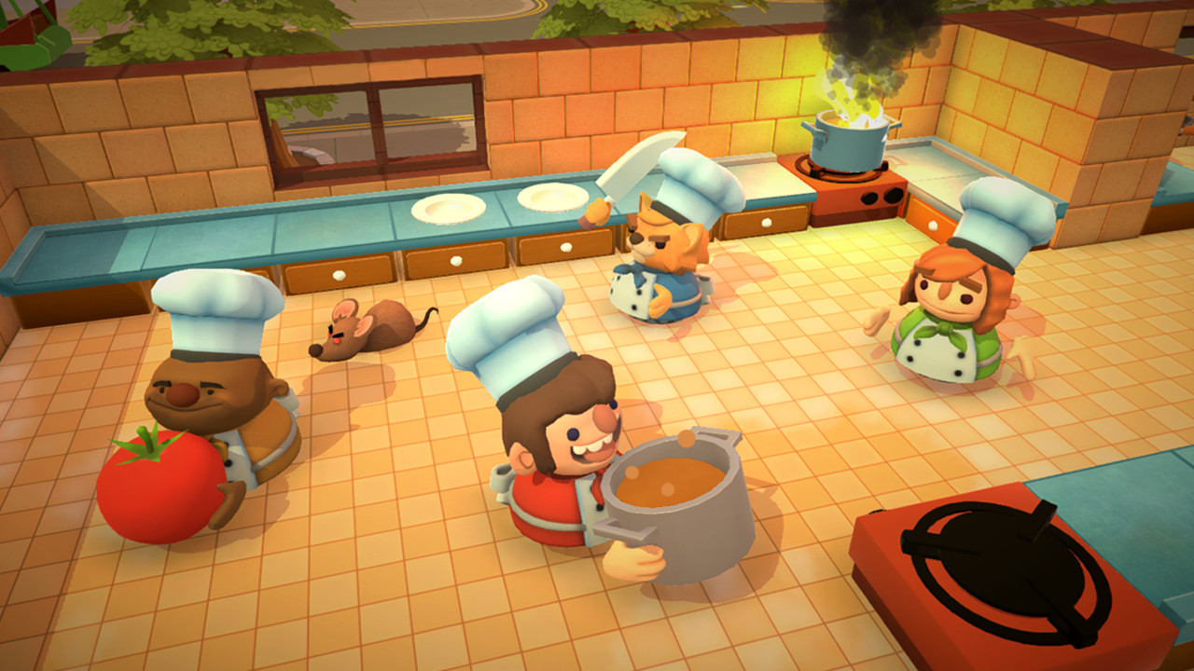
FRIENDLY
EMOTIONAL
Notes:
Games can definitely be family-friendly, like Overcooked. A cooperative game in which up to 4 chefs have to use their skills in order to cook and serve food to different restaurants.

Slide 23
There’s a video game for everyone.
You do socialize while playing.
Final ideas
Before wrapping it all up there are three important things to mention before ending the presentation.
There are good things, and bad ones.
Notes:
I know some may consider that video games are truly not for them, but I can guarantee that there is a video game out there for anyone.
No, they don't really make people to avoid social interaction, if anything, they will encourage it, either through text or voice chat. Plus, an introvert will not go out even if he or she is not playing a video game.
There are so many good things and advantages when it comes to video games, but I cannot deny the fact that they can also have a negative impact. However, in my opinion, the bad things only appear after the addiction sets in. But after all, no addiction is good. No matter what.

Slide 24
There’s a video game for everyone.
Bibliography
Small Caps – Evolution of video games
Game Industry – Game Revenues in 2017
Visual Capitalist – History of video games
Newzoo – Top 100 countries in game revenue
Vgsales – List of highest grossing video games
BigFishGames – 2017 video game statistics
You do socialize while playing.
Thank you!
There are good things, and bad ones.
Notes:
Thank you!

